Slide 1

CSE 299 Junior Design Course
Rahman Farhat Lamisa
1731068042
Group: 01

Slide 2
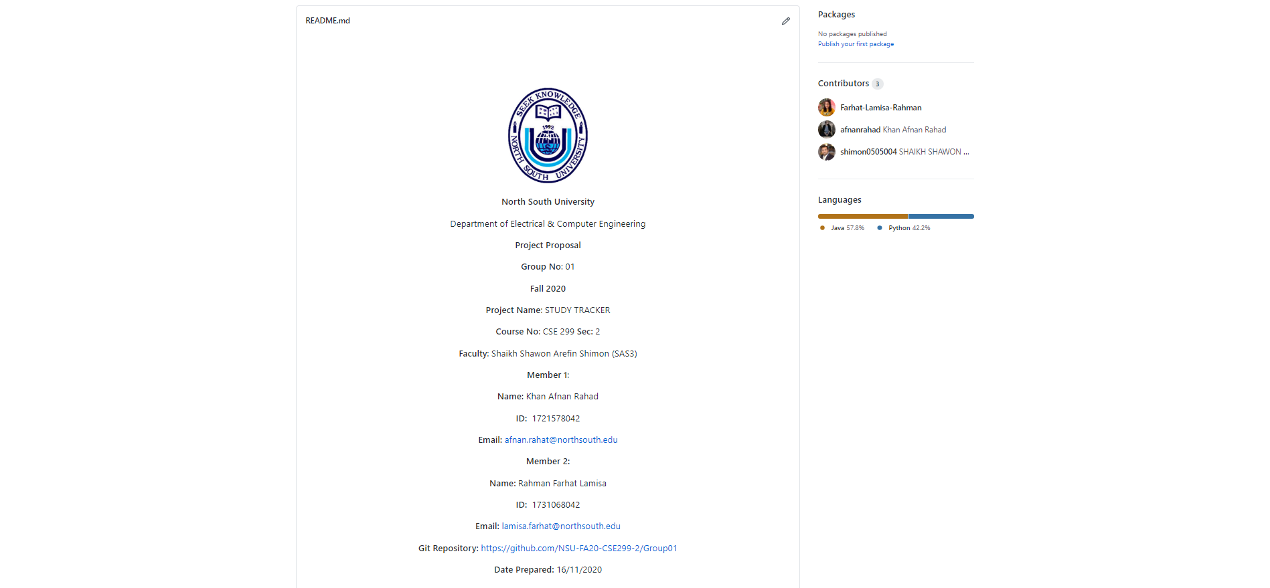
Readme.md

Slide 3
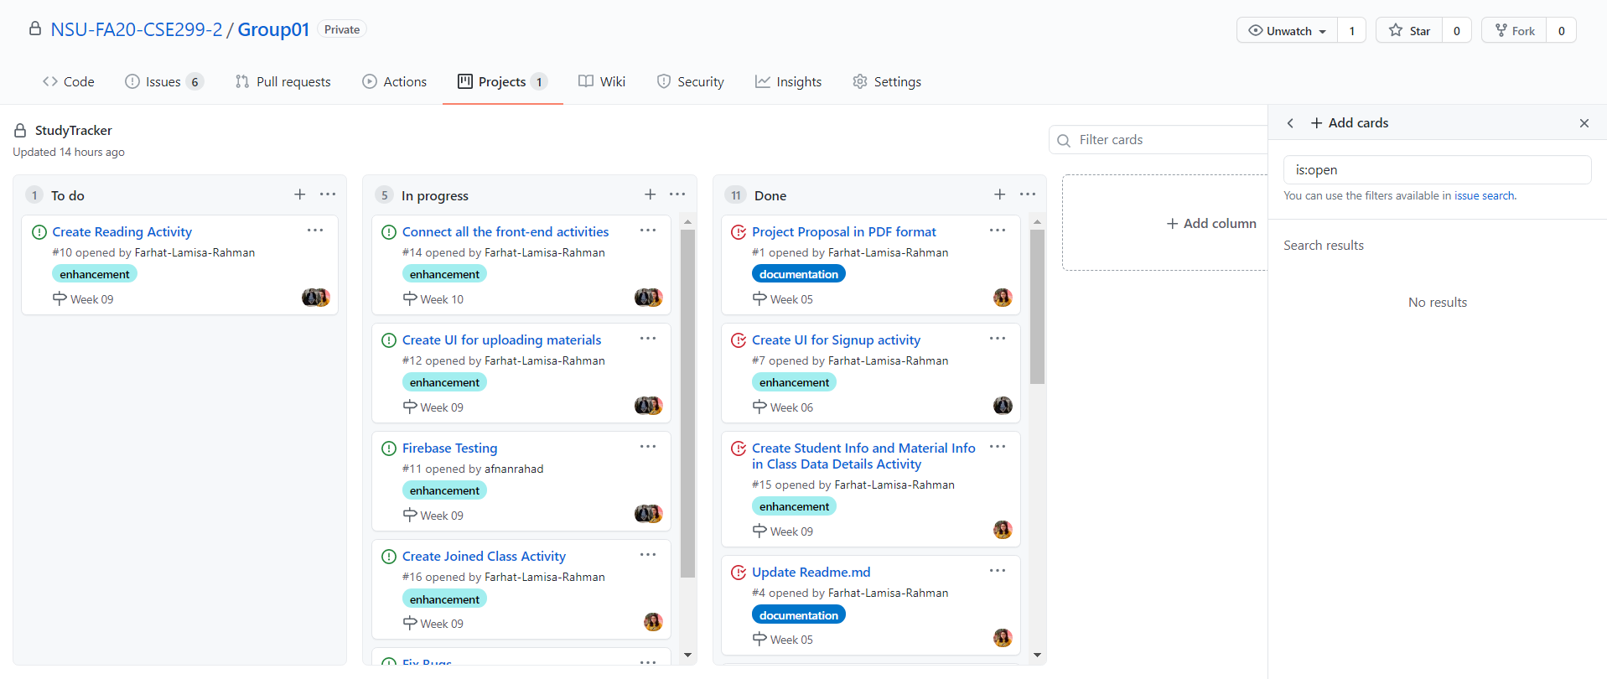
Issue Board

Slide 4
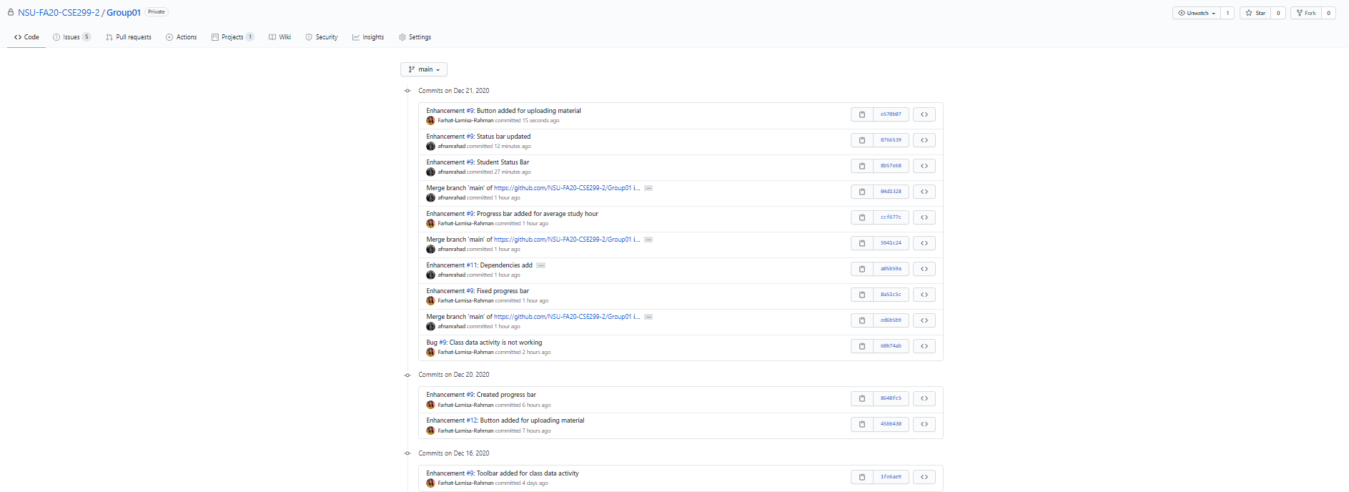
Week 9's commits

